Slide 1
Bennett University
School of Computer Science Engineering and Technology
CSET305 – Multi-Core Computer Architecture

Slide 2
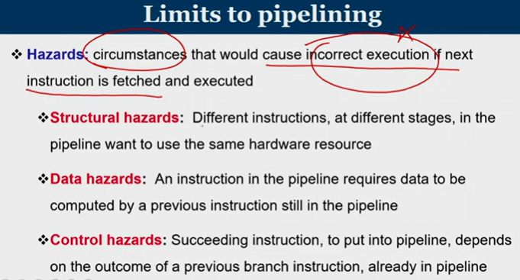

Slide 3
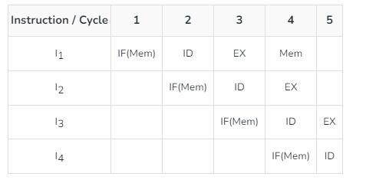
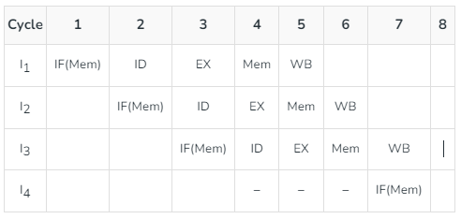
Structural dependency
This dependency arises due to the resource conflict in the pipeline.
A resource conflict is a situation when more than one instruction tries to access the same resource in the same cycle. A resource can be a register, memory, or ALU.
Example:
In this scenario, in cycle 4, instructions I1 and I4 are trying to access same resource (Memory) which introduces a resource conflict.
To avoid this problem, we have to keep the instruction on wait until the required resource (memory in our case) becomes available.
This wait will introduce stalls in the pipeline as shown below:

Slide 4
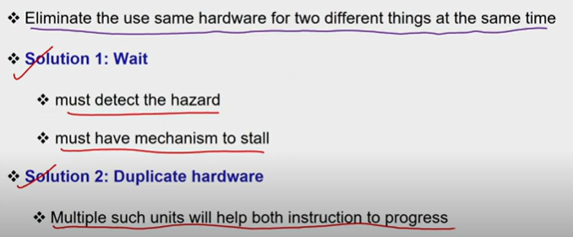
Solution for structural dependency

Slide 5
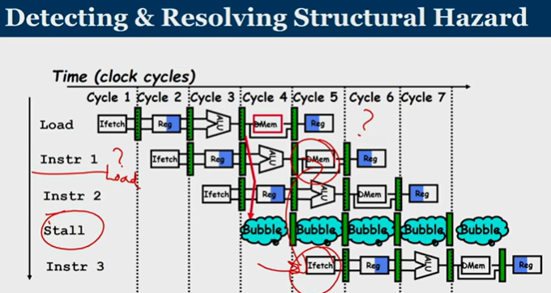

Slide 6
Data dependency
Data hazards occur when instructions that exhibit data dependence, modify data in different stages of a pipeline.
Hazard cause delays in the pipeline.
There are mainly three types of data hazards:
  RAW (Read after Write) [Flow/True data dependency]
  WAR (Write after Read) [Anti-Data dependency]
  WAW (Write after Write) [Output data dependency]

Slide 7
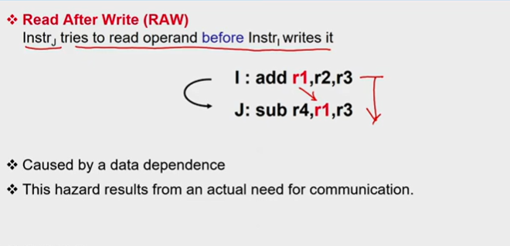

Slide 8
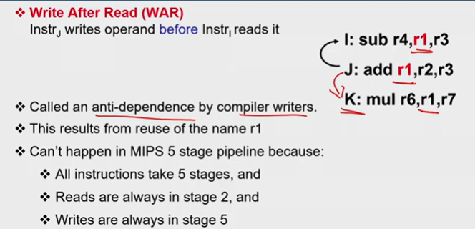

Slide 9
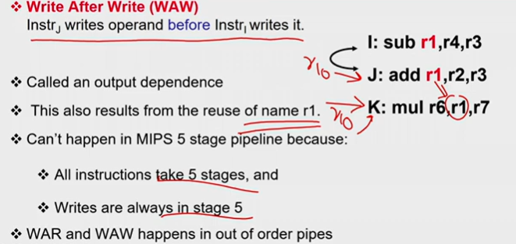

Slide 10

Thank You and Queries

